Slide 1

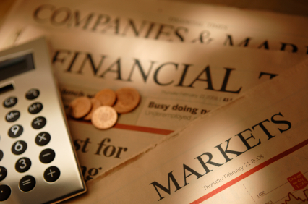

AcF 304 Financial Markets
Topic 5 - The Foreign Exchange Market
Notes:
If this PowerPoint presentation contains mathematical equations, you may need to check that your computer has the following installed:
1) MathType Plugin
2) Math Player (free versions available)
3) NVDA Reader (free versions available)

Slide 2
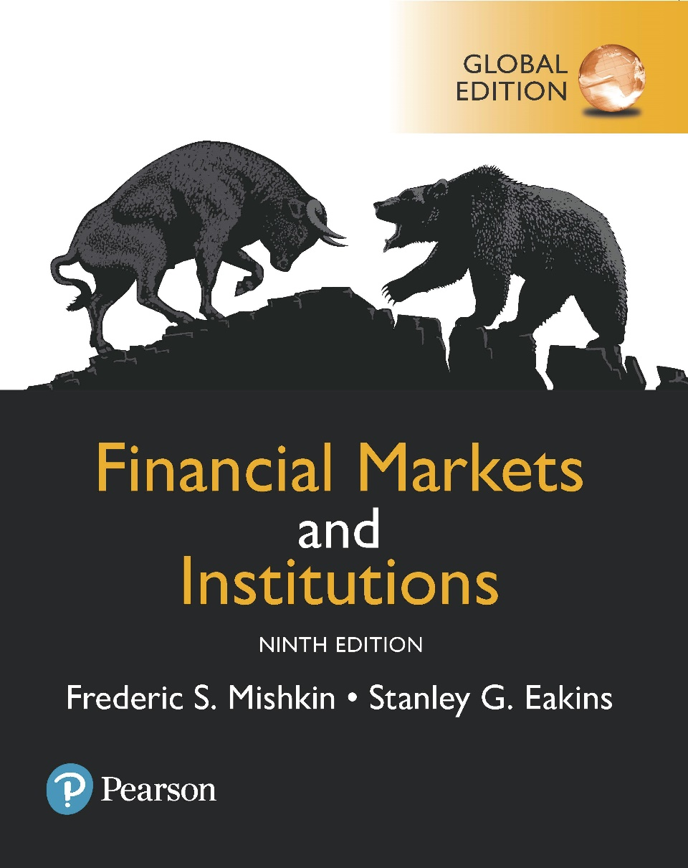
Financial Markets and Institutions
Ninth Edition, Global Edition
Additional reading – Chapter 15 The Foreign Exchange Market – however we focus on the topic slides and seminar material for this topic (including for assessment purposes).
Notes:
If this PowerPoint presentation contains mathematical equations, you may need to check that your computer has the following installed:
1) MathType Plugin
2) Math Player (free versions available)
3) NVDA Reader (free versions available)

Slide 3
Chapter Preview (1 of 2)
In the mid-1980s, American businesses became less competitive relative to their foreign counterparts. By the 2000s, though, competitiveness increased. Why?
Part of the answer can be found in exchange rates. In the 1980s, the dollar was strong, and US goods were expensive to foreign buyers.
By the 1990s and 2000s, the dollar weakened, so American goods became cheaper and American businesses became more competitive.

Slide 4
Chapter Preview (2 of 2)
In this chapter, we will introduce the basic theory behind Exchange Rates in the Short Run and Long Run.
We will look at ‘Spot’, ‘Forward’, and ‘FX Swaps’ transactions.
We also will spend considerable time focussing on how the market really works and the real-world FX landscape!
We will finish with a look at where the US Dollar is today.

Slide 5
Why trade FX?
Financial institutions generally engage in foreign exchange trading activities for the following purposes:
a) The buying and selling of foreign currencies on behalf of their customers so as to allow their customers to engage in and complete international trading transactions with counterparties.
b) The buying and selling of foreign currencies on behalf of their customers (or on its own behalf) in order to take positions of a speculative nature in foreign exchange or other financial instruments.
c) The buying and selling of foreign currencies for hedging purposes to offset customer (or its own) exposure to any given currency.

Slide 6
Why Study Financial Markets? The Foreign Exchange Market
FX fluctuations matter!
At various times US consumers have found that vacationing in Europe is expensive, due to a weakening dollar relative to the Euro.
UK consumers pay a lot more to travel to Europe since Sterling’s fall over Brexit
But UK exporters now find it easier to sell goods!
FTSE 100 share index is boosted as GBP falls!

Slide 7
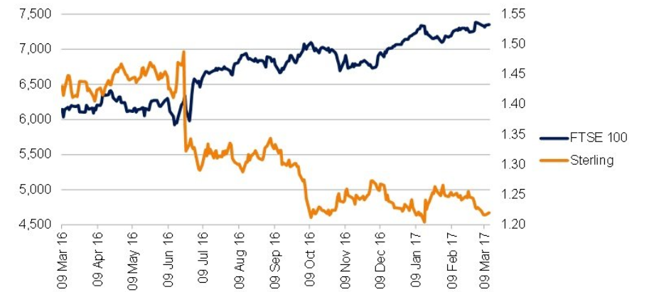
FTSE 100 vs GBP

Slide 8
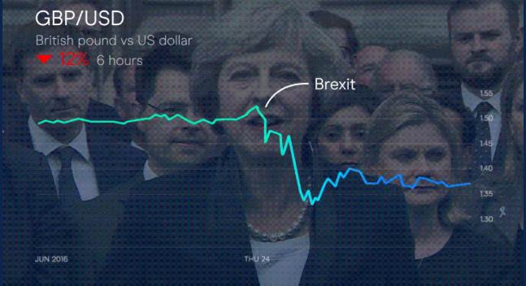
GBP & BREXIT

Slide 9
Foreign Exchange Market (1 of 2)
Most countries have their own currencies: the U.S. dollar, the euro in Europe, the Brazilian real, and the Chinese yuan, just to name a few.
The trading of currencies is what makes up the foreign exchange market.

Slide 10
What are Foreign Exchange Rates?
Spot Transactions – involving immediate (2-day) exchange of currencies
Forward Transactions – exchange some time in the future
Currency increases in value = appreciation
Currency decreases in value = depreciation
Beginning 1999: 1 EUR = $1.18
June 16, 2016: 1 EUR = $1.11
The Euro depreciated by 6%: (1.11-1.18)/1.18 = -0.06
USD appreciated by 6%
This affects the price of US goods in Europe and vice versa

Slide 11
What are Exchange Rates Important?
This affects the price of US goods in Europe and vice versa
A US consumer John decides to buy a bottle of vintage French wine.
EUR cost 1,000. If EUR/USD is 1.11. US cost $1,100
If delays purchase and EUR appreciates EUR/USD 1.40
EUR cost 1,000. If EUR/USD is 1.40. US cost $1,400
EUR has appreciated making the cost of European goods more expensive in US (as need more dollars to buy such goods-dollar has weakened/depreciated).

Slide 12
What are Exchange Rates Important?
The same currency appreciation however has made the price of US goods in Europe less expensive.
At EUR/USD 1.11 …a $2000 Lenovo laptop costs
2000/1.11=EUR 1,801.80
At EUR/USD 1.40 …a $2000 Lenovo laptop costs
2000/1.40=EUR 1,428.57
A strengthening of a currency (EUR v USD) makes foreign /US goods cheaper in Europe BUT makes European goods more expensive in the US

Slide 13
How is Foreign Exchange Traded?
FX traded in over-the-counter market
Involve buying / selling cash denominated in different currencies.
Trades involve transactions in excess of $1 million made by institutions e.g. banks
Typical retail consumers i.e.you/me buy foreign currencies from retail dealers, such as Western Union / American Express/ high street banks.
FX volume exceeds $5 trillion per day!!

